Slide 1
BRITISH AIRWAYS
PREDICTIVE MODEL AND ITS RESULTS

Slide 2
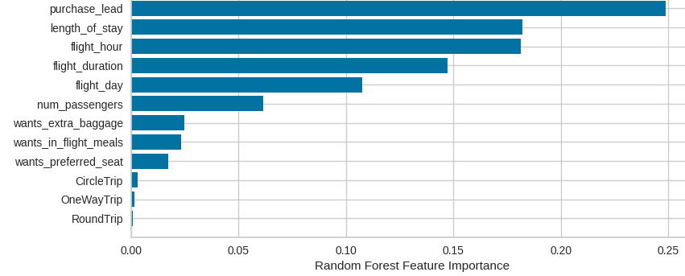
PREDICTIVE MODEL RESULTS
Recall Score
59%
Precision Score
60%
Top features that can drive successful flights for BA
Chances of predicting true successful bookings.
68% chances of predicting true incomplete bookings correctly.
C
Will be predicted as actually completed bookings out of all the successfully completed bookings.
C
Accuracy of the model
predicting successful or
incomplete bookings is
Accuracy
61%
We are concerned with predicting the unsuccessful bookings correctly. Imbalanced data drives higher accuracy but it doesn‘t accurately predict the unsuccessful bookings.
Dataset was balanced with 8k labelled as incomplete bookings and 7k as complete bookings.

